Slide 1


Infographics on JU Admission Test Process
A Bit to Byte Production House

Slide 2






OUR TEAM
Rifat Ara
Shahrin Khan
Israt Jahan Munny
Md Anayet Ullah
Md Asoad Alvi Yanur Saom
Ikramul Islam Emon
Jannatul Ferdaws Amrin

Slide 3
Problem Statement
The crucial part for an examinee is to
understand the requirements of applying.
understand the correct information on each unit.
However, an unorganized and poorly visualized document causes a variety of issues, including -
Missing crucial facts.
Conflict with the requirements of one unit to other units.
Not understanding the comprehend all of the points made in documents.

Slide 4

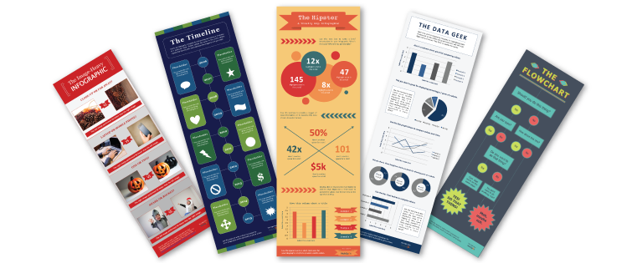
Solution
INFOGRAPHICS
VIDEO

Slide 5
Objectives
To visualize the entire admissions test procedure at a glance.
To convey the correct information of each unit and proper overview of each unit.
01
03
To avoid confliction of different units admission criteria.
To make an effective and efficient admission process
02
04

Slide 6
Progress Summary of Week 01
Date/Location: 18-Nov-2022 (Google Meet)
Attendees: Israt Jahan Munny (IJM), Rifat Ara (RA), Jannatul Ferdaws Amrin (JFA), Shahrin Khan (SK), Ikramul Islam Emon (IIE), Md. Asoad Alvi YaNur Saom (AAYS), Md. Anayet Ullah (AU)
Duration: 11:00pm - 11:35pm
Decisions:
Brainstorming
Group name and Idea Selection
Resource collection
Roles and Responsibilities Distribution
Budget Estimation
Meeting Schedule

Slide 7
Result
Roles & Responsibilities:
Producer: Dr Mohammad Zahidur Rahman.
Project Manager: Amrin
Graphic Designer: Shahrin
Script Writer: Saom, Anayet, Munny
Voice Artist: Emon
Sound Designer: Rifat
Required Tools:
Design: Inkspace, GIMP, Canva
Audio: Audacity, KDENlive, Ardour6
Management: Trello, GanttProject.

Slide 8
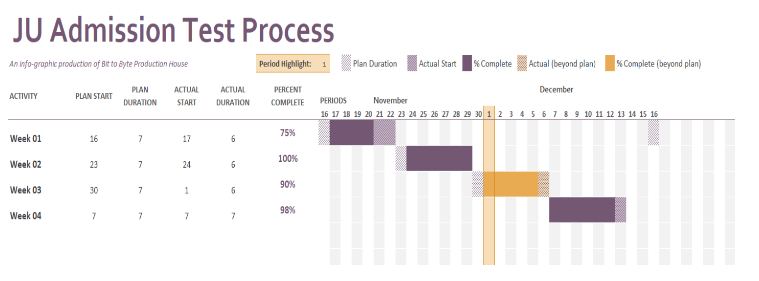
Result
Gantt Chart:

Slide 9
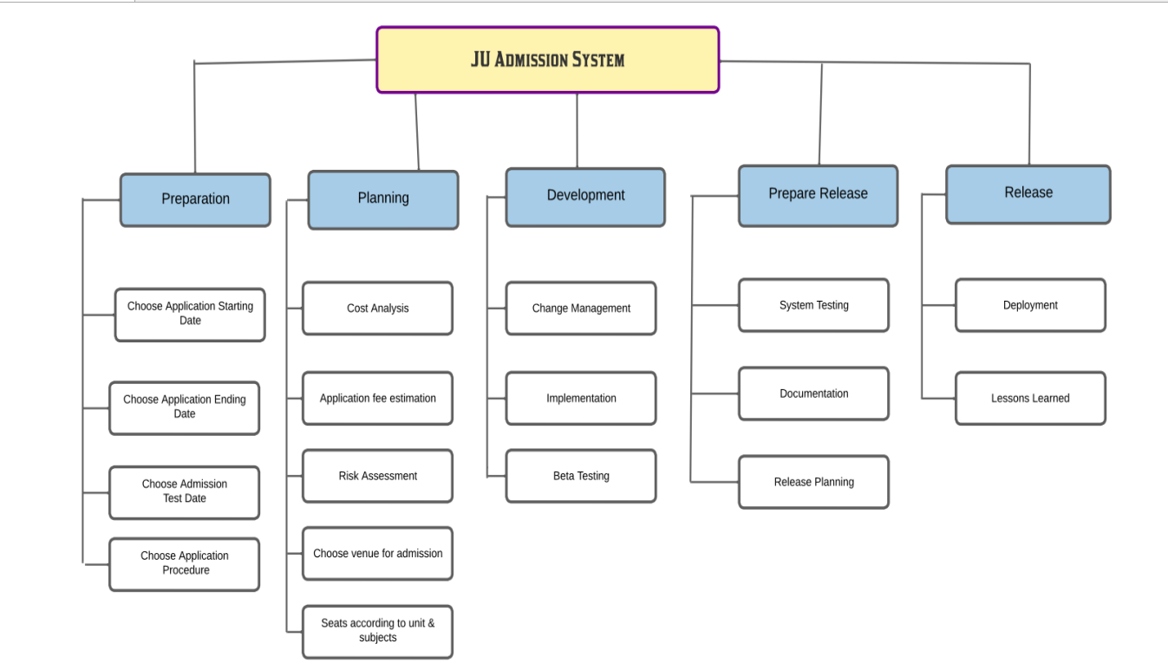
Result
Work Break-Down Structure:

Slide 10


Result
Group Name:
Bit to Byte Production
Logo Design:

Slide 11
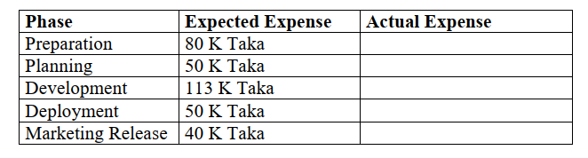
Result
Budget Estimation:

Slide 12

Hindrance
Language Selection
Budget Estimation

Slide 13
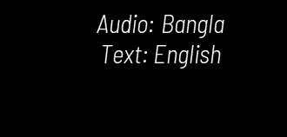
Solutions
Depending on individual work

Slide 14
Progress Summary of Week 02
Date/Location: 23-Nov-2022 (Google Meet)
Attendees: Israt Jahan Munny (IJM), Rifat Ara (RA), Jannatul Ferdaws Amrin (JFA), Shahrin Khan (SK), Ikramul Islam Emon (IIE), Md. Asoad Alvi YaNur Saom (AAYS), Md. Anayet Ullah (AU)
Duration: 10:00pm - 10:40pm
Decisions:
Collect necessary information, materials for project content and design
Designing the outline
Formatting the content
Writing the scripts
Learning the uses of tools as well as design some parts of infographics

Slide 15
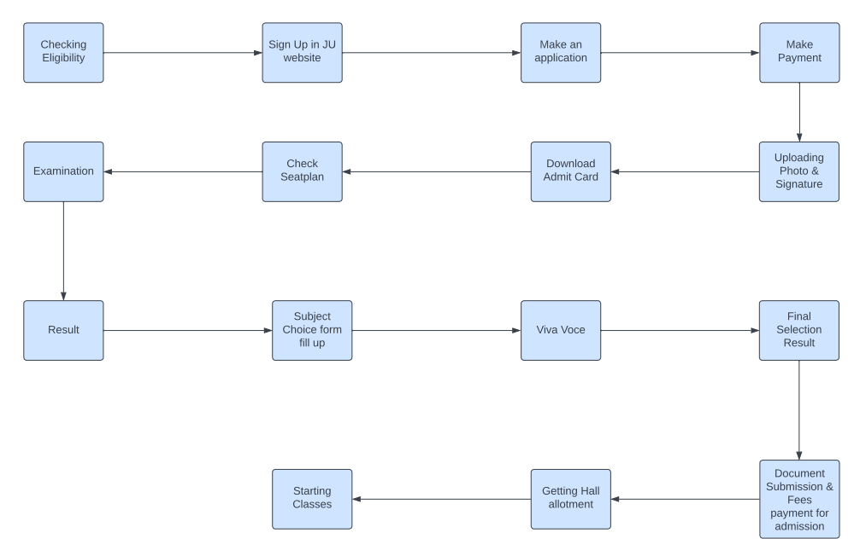
Result
Flowchart:

Slide 16
Assigned member in Documentation and Design part
starting design some parts of infographics
Collect information on faculty of Mathematics and Physics
Logo Design
Collect necessary materials for design
Collect information on faculty of Arts and Humanities and faculty of Business studies
Collect information on faculty of Biological Sciences
Collect information on faculty of social sciences and faculty of law
04
04
05
06
01
02
03
JFA
IIE
MAAYS
IJM
SK
MAU
RA

Slide 17
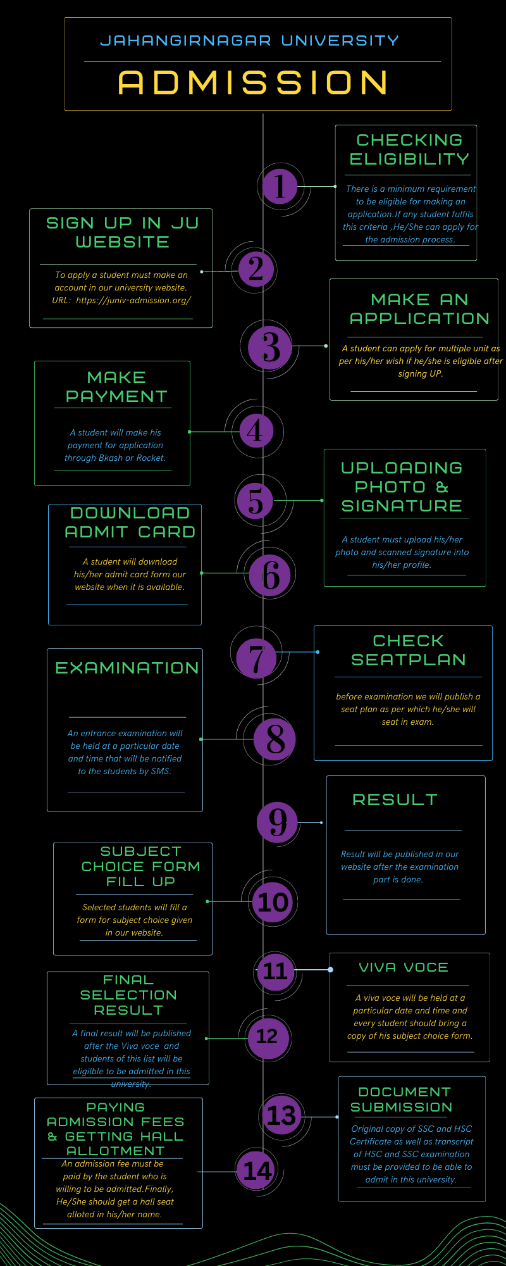
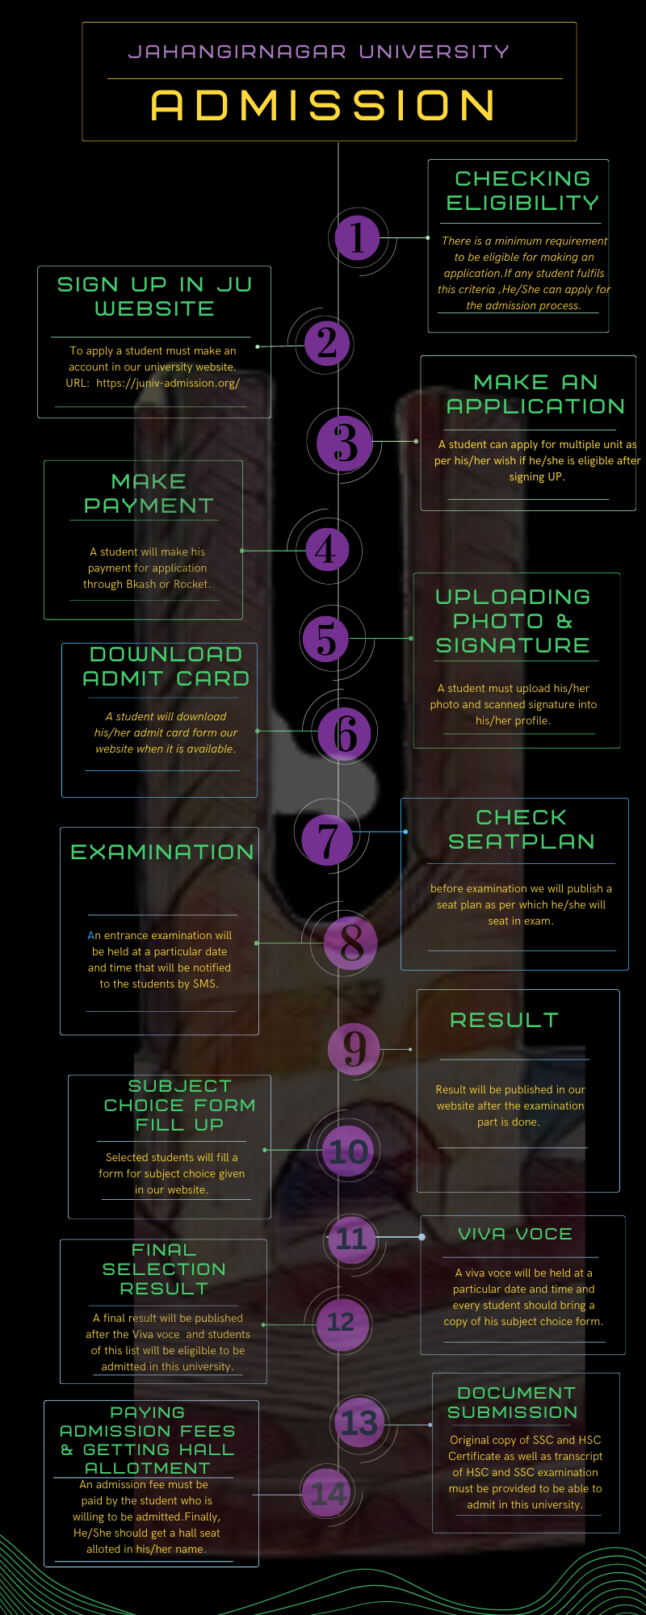
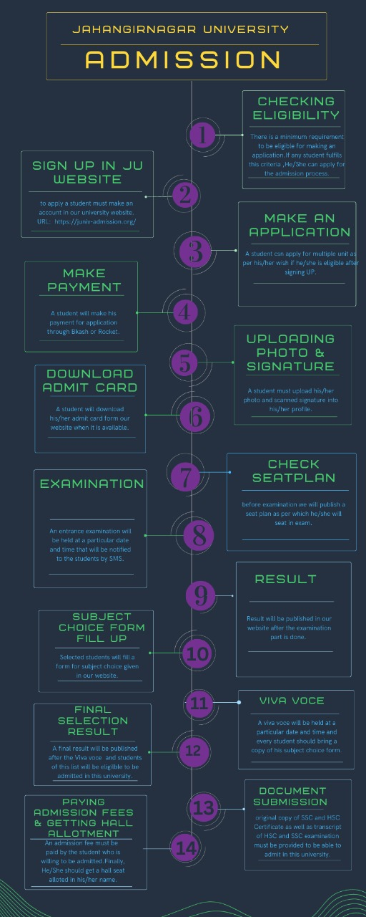
Initial Version of Infographics:

Slide 18
Hindrance
Selection of Color & themes
Writing Scripts

Slide 19
WHOA!
We have arrived in our THIRD week!!!!

Slide 20
Planning of Week 03
01.
Writing the Scripts (Due on Week 02)
02.
Implementing the design in the video tools
03.
Adding text content and voice in the video
Synchronizing the audio
04.
Schedule a meeting to distribute works among team
05.

Slide 21
AHH!. Slide has Ended

Slide 22
THANKS!

Slide 23
Do You have any QUESTIONS
Search
??????

